Slide 1


Investigate your ML model’s prediction🔬
Sara El-Ateif
@el_ateifSara
@sara.elateif (Medium)/ elateifsara.github.io

Slide 2


TFUG Casablanca
TensorFlow User Group Casablanca (TFUG Casablanca) is a local community of technologists who are interested in advancing their knowledge of TensorFlow, its use cases, and applications. So far, it has reached 1k members in its Facebook group.

Slide 3
Plan
XAI tools
Diabetic Retinopathy (DR)
Explainable AI (XAI)
Grad CAM
Conclusion
Experiments

Slide 4




Section title goes here
Explainable AI (XAI)

Slide 5
What is XAI?
Explainable AI is a set of tools and frameworks to help you understand and interpret predictions made by your machine learning models. With it, you can debug and improve model performance, and help others understand your models' behavior.

Slide 6
Model Interpretation
Interpretability is the degree to which a human can understand the cause of a decision.
The three most important aspects of model interpretation are:
- Transparency
- The ability to question
- The ease of understanding
Source: Dphi XAI course
Notes:
Model Interpretation : Model Interpretation is something which can make or break a real-world machine learning project in the industry. It helps us come one step closer to explainable artificial intelligence (XAI). Interpretability is the degree to which a human can understand the cause of a decision. Model interpretation tries to understand and explain the decisions taken by the model, i.e., the what, why and how. The three most important aspects of model interpretation are:
Transparency
The ability to question
The ease of understanding
Source: Dphi XAI course

Slide 7




Global & Local interpretation
Global: looking at the entire dataset, some features are the most predictive.
Local: a certain feature (like age) is the most important feature for making a certain prediction.
Notes:
Model Interpretation : Model Interpretation is something which can make or break a real-world machine learning project in the industry. It helps us come one step closer to explainable artificial intelligence (XAI). Interpretability is the degree to which a human can understand the cause of a decision. Model interpretation tries to understand and explain the decisions taken by the model, i.e., the what, why and how. The three most important aspects of model interpretation are:
Transparency
The ability to question
The ease of understanding
Source: Dphi XAI course

Slide 8



Why XAI?
Training data
?
🧑‍💻
Why did you do that?
Why not something else?
When do you succeed?
When do you fail?
When can I trust you?
How do I correct an error?
Learning Process
Model
Cat
Notes:
If your dog kills someone, it's probably not the dog that will be subject to a lawsuit.

Slide 9
🤛🤛🤛🤛
Why XAI?
Training data
🤛
🧑‍💻
I understand why
I understand why not
I know when:
You will suceed
You will Fail
To trust you
I know why you erred
New learning process
Model
Cat
It has fure, whiskers and claws

Slide 10
Section title goes here
XAI tools/libraries

Slide 11
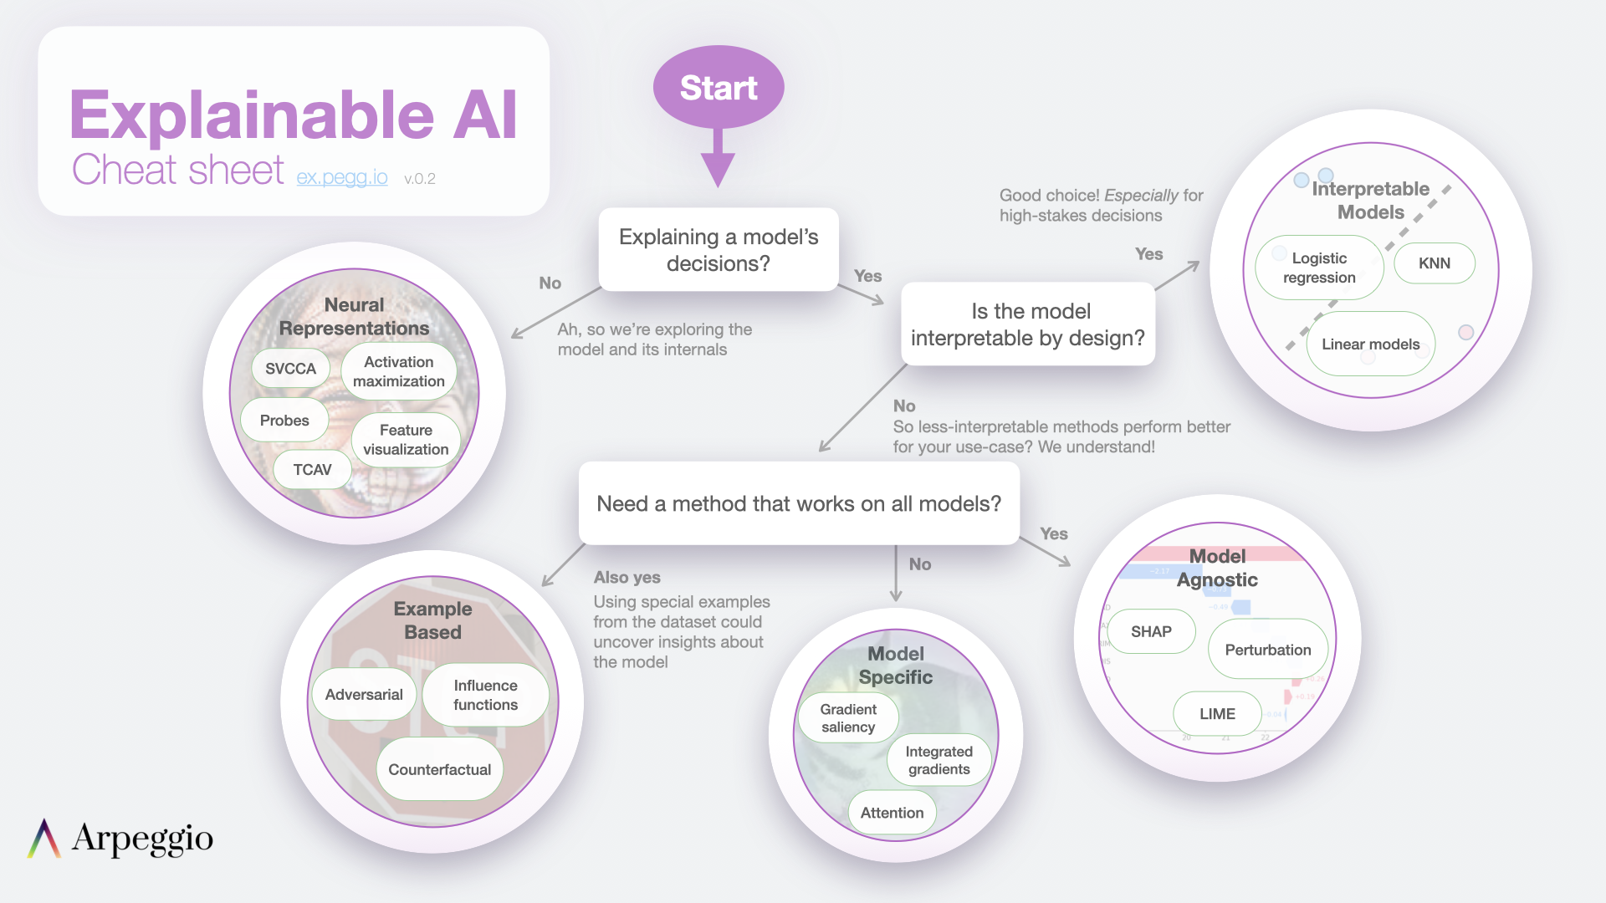
Tools/Libraries

Slide 12
Section title goes here
Diabetic Retinopathy (DR)

Slide 13
Definition
‘Diabetic Retinopathy (DR) is a complication of diabetes, caused by high blood sugar levels damaging the back of the eye (retina). It can cause blindness if left undiagnosed and untreated.’
Source: NHS UK
‘Globally, the number of people with DR will grow from 126.6 million in 2010 to 191.0 million by 2030.’
Source: 10.4103/0301-4738.100542

Slide 14
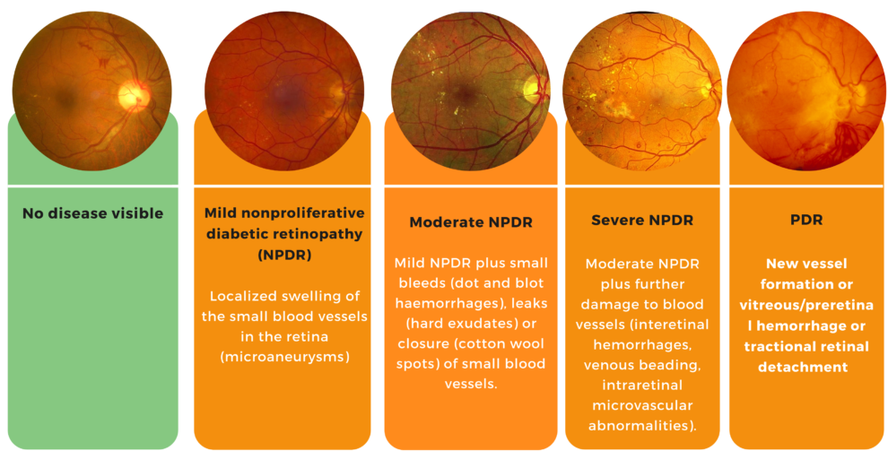
Symptoms by grade
Source: https://www.ophthalytics.com/our-technology/diabetic-retinopathy/

Slide 15
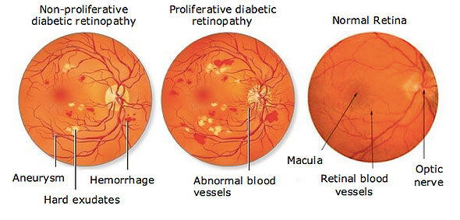
Symptoms by grade
Source: https://lowvisionaids.org/diabetic-retinopathy/

Slide 16
Section title goes here
Grad CAM

Slide 17
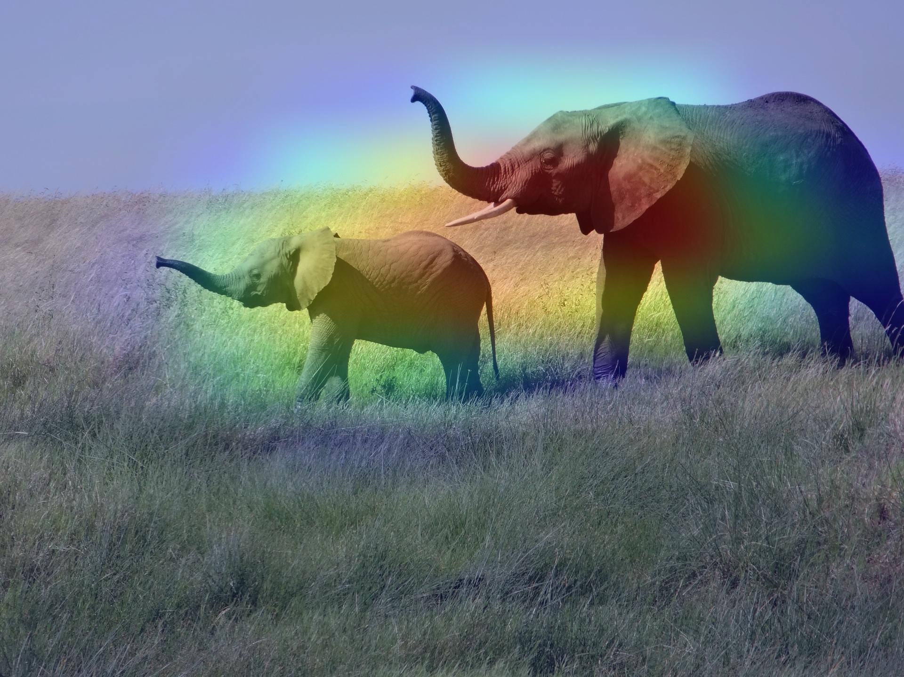
Definition
Gradient-weighted Class Activation Mapping (Grad-CAM), uses the gradients of any target concept, flowing into the final convolutional layer to produce a coarse localization map highlighting important regions in the image for predicting the concept.
Source: arXiv:1610.02391
Source: https://keras.io/examples/vision/grad_cam/

Slide 18
Section title goes here
Experiments

Slide 19
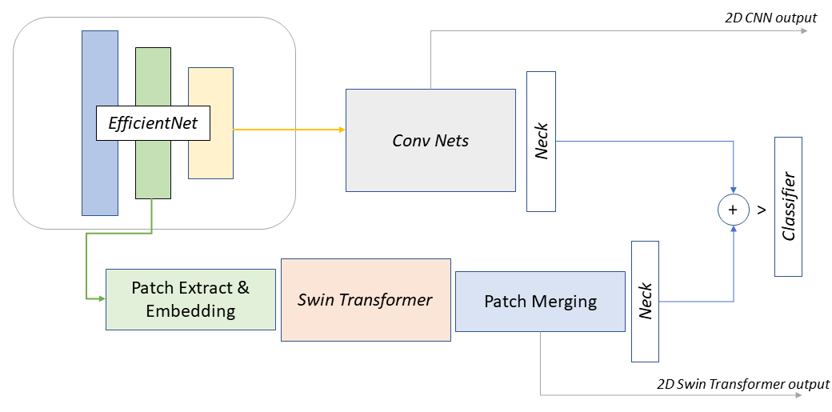
Model
Source: https://www.kaggle.com/code/ipythonx/tf-hybrid-efficientnet-swin-transformer-gradcam/notebook
Notes:
block6a_expand_activation => from (384,384) to 24x24

Slide 20
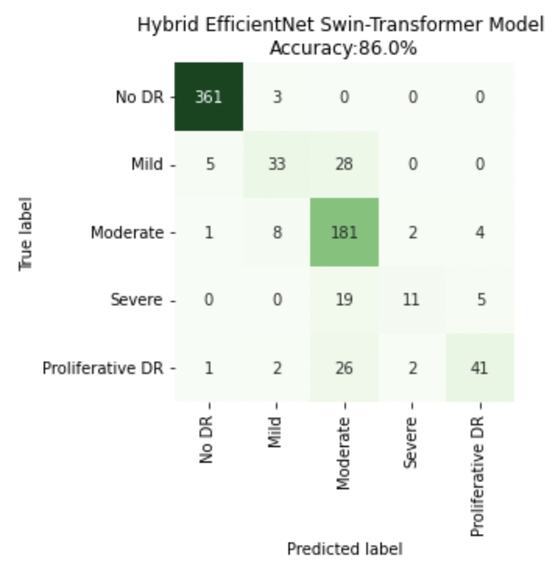
Confusion Matrix
In brief:
No DR confused as Mild
Mild confused as No DR and Moderate
Moderate confused as (mainly) Mild, Severe and PDR
Severe confused as Moderate and PDR
PDR confused (mainly) as Mild, Moderate and Severe

Slide 21
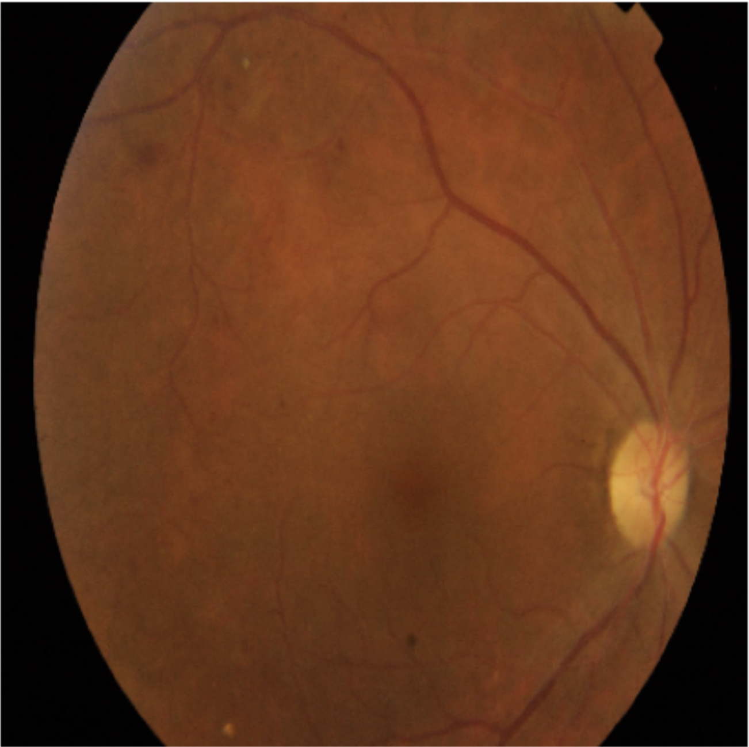
Understand the model: Failures
Mild mistaken as Moderate DR
Notes:
Normally, Moderate on top of symptoms of Mild (swelling of blood vessels),

Slide 22
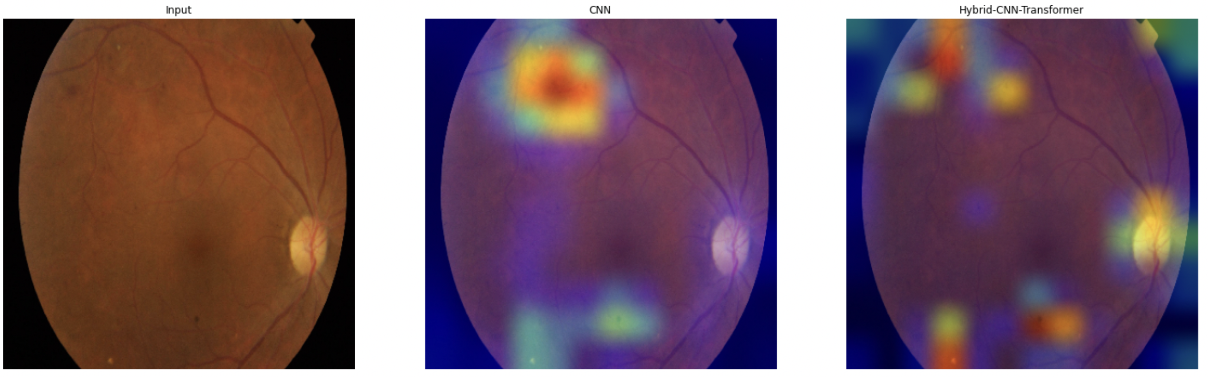

Understand the model: Failures
Mild mistaken as Moderate DR
Notes:
Normally, Moderate on top of symptoms of Mild (swelling of blood vessels),
I wouldn’t call this moderate

Slide 23
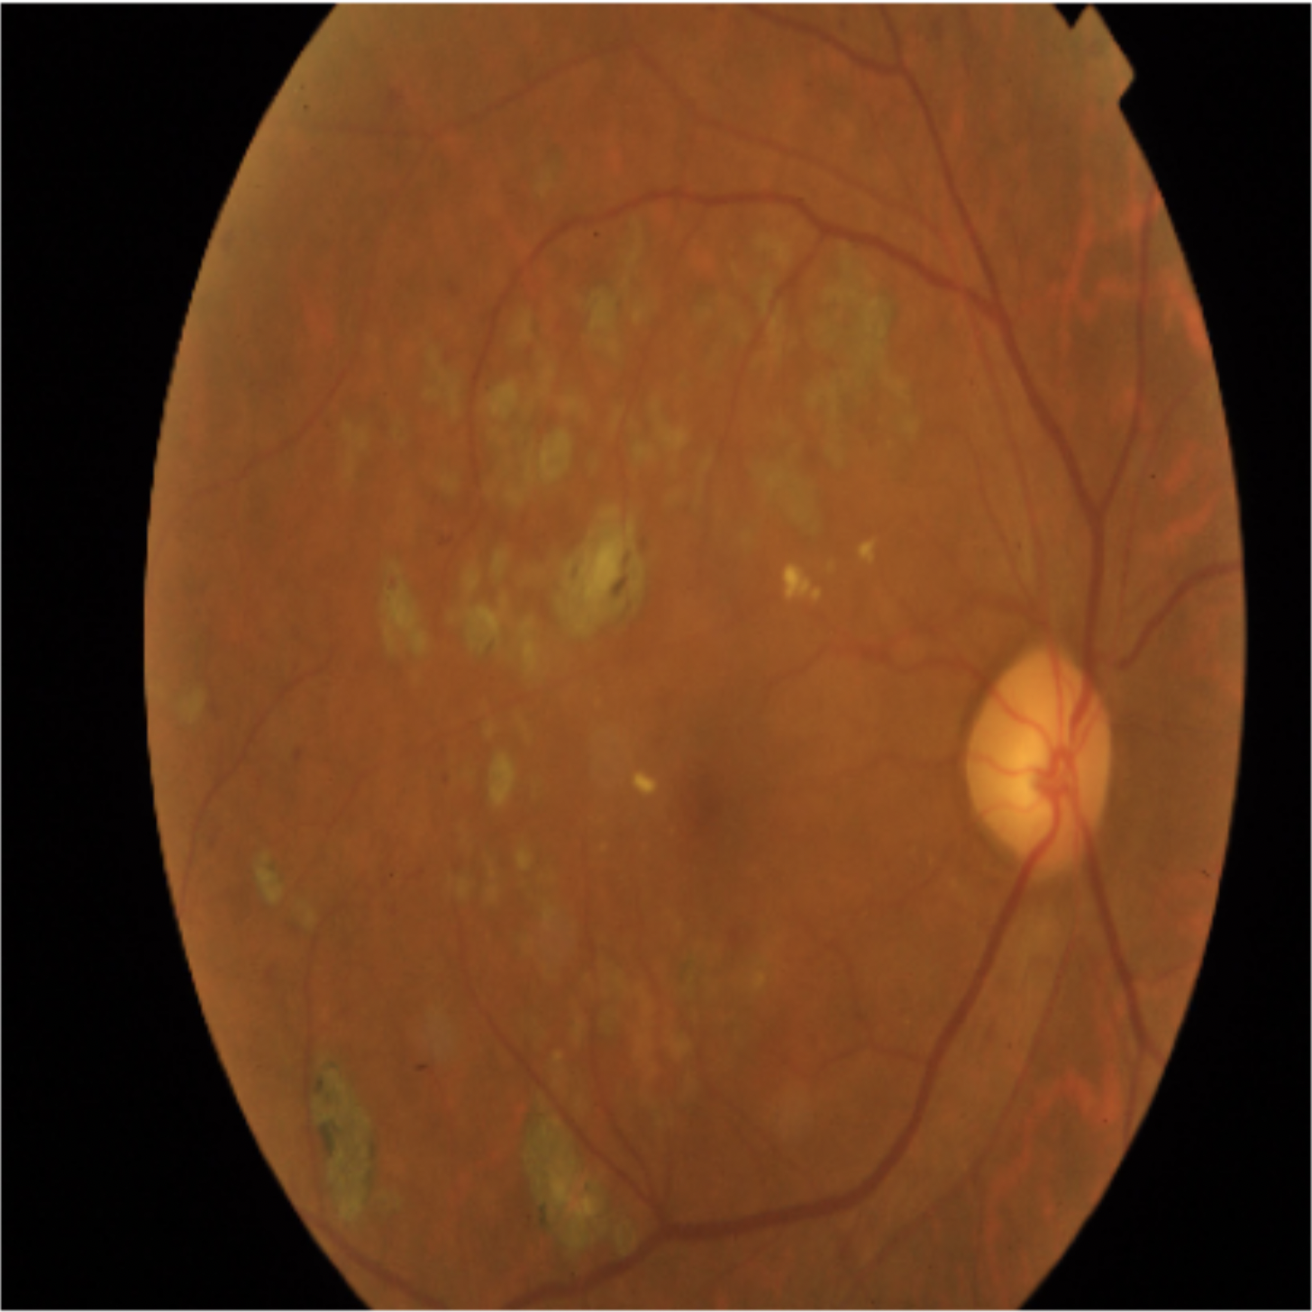
Understand the model: Failures
Moderate mistaken as Proliferative DR
Notes:
Normally, Moderate on top of symptoms of Mild (swelling of blood vessels),

Slide 24
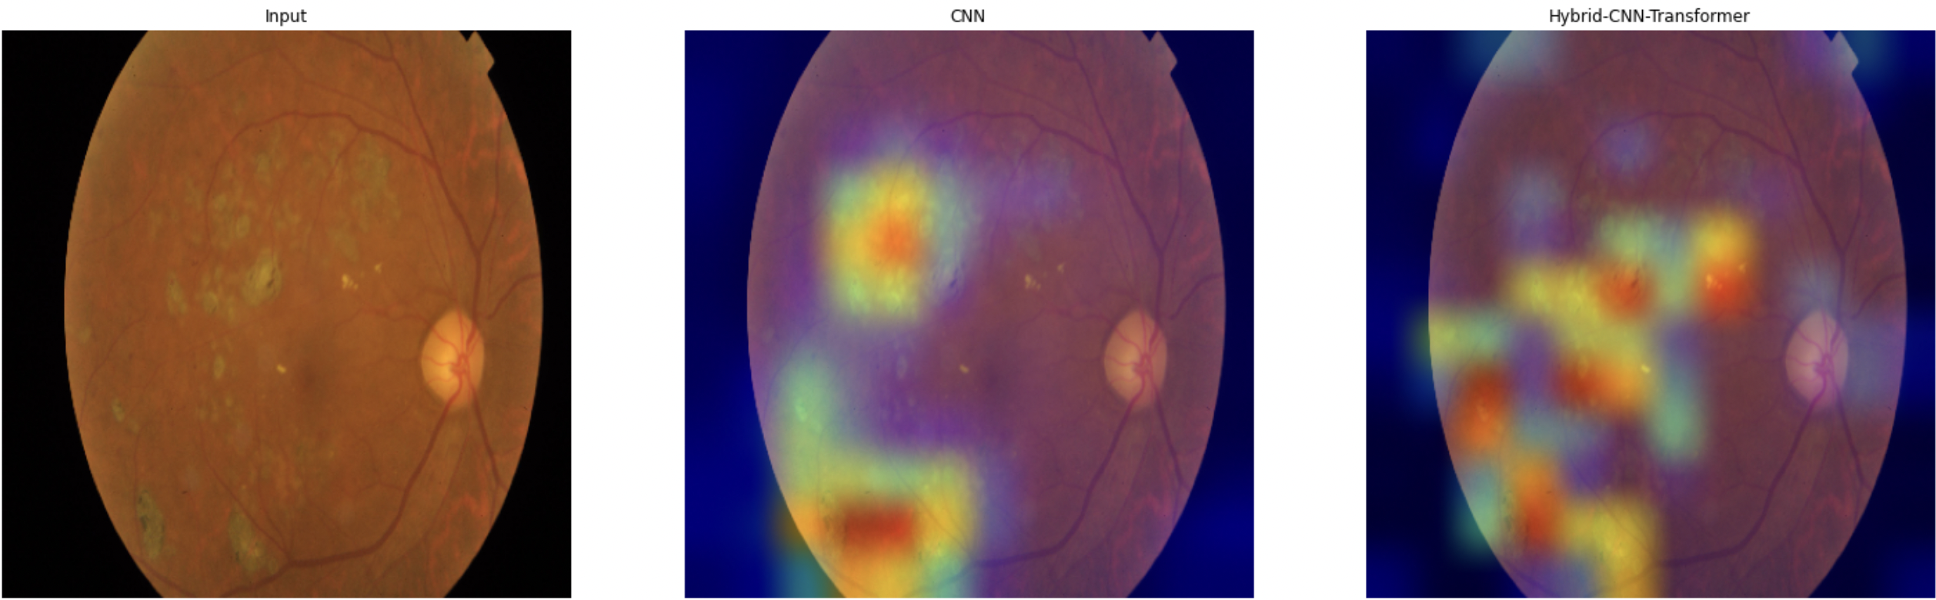

Understand the model: Failures
Moderate mistaken as Proliferative DR
Notes:
Normally, Moderate on top of symptoms of Mild (swelling of blood vessels),
I wouldn’t call this moderate as I see No hemorrages, or hard exudates (the yellow spots), or cotton wool

Slide 25
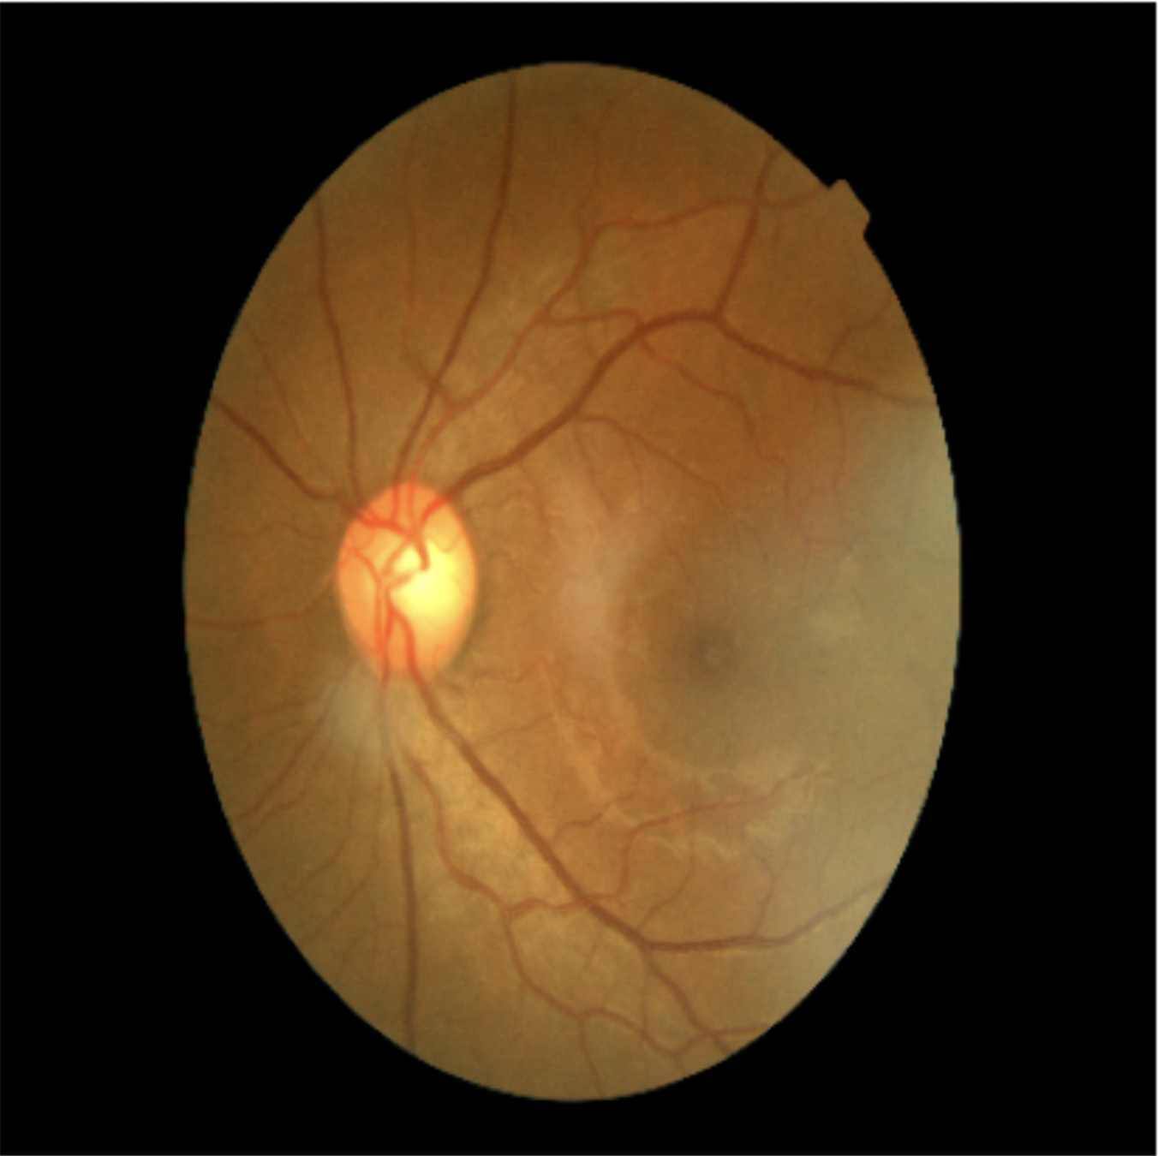
Understand the model: Success
No DR

Slide 26
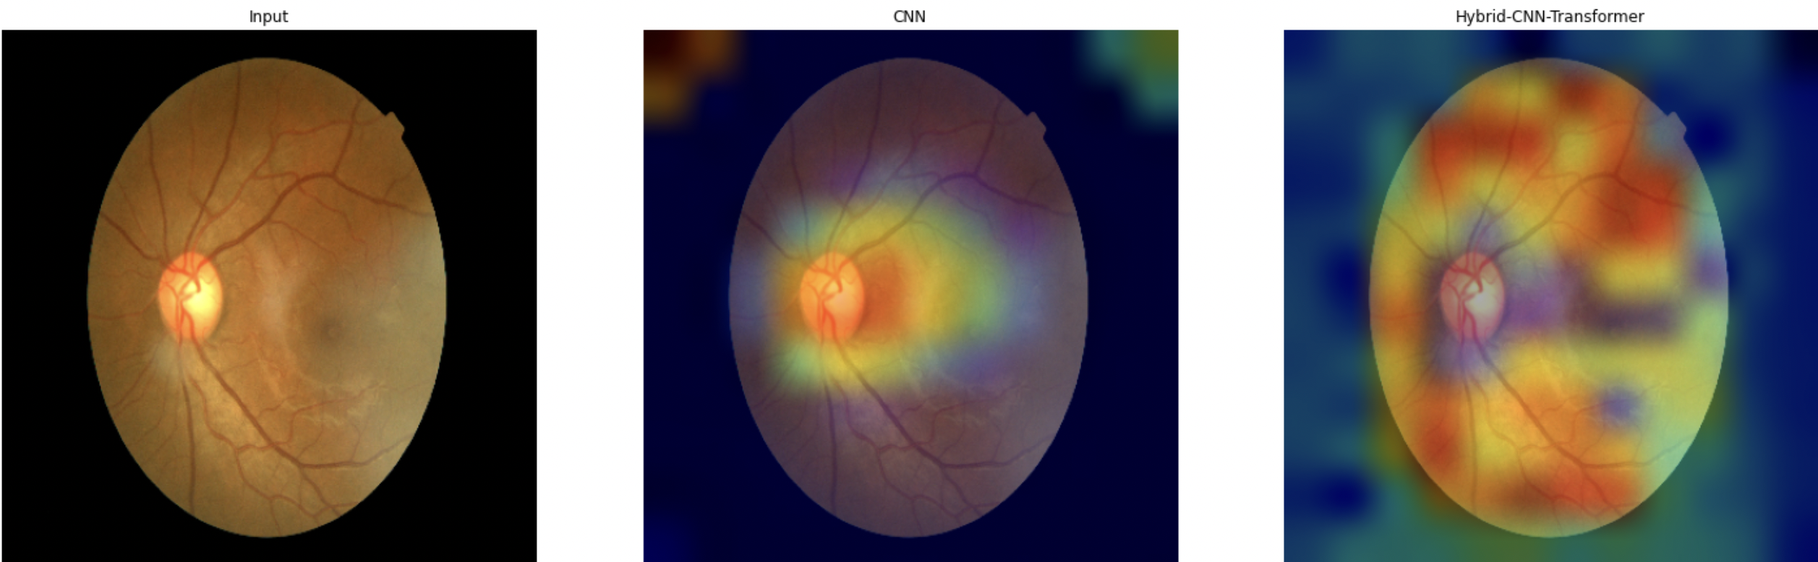
Understand the model: Success
Notes:
The Swin Transformer model looked at all the areas before taking its decision.

Slide 27
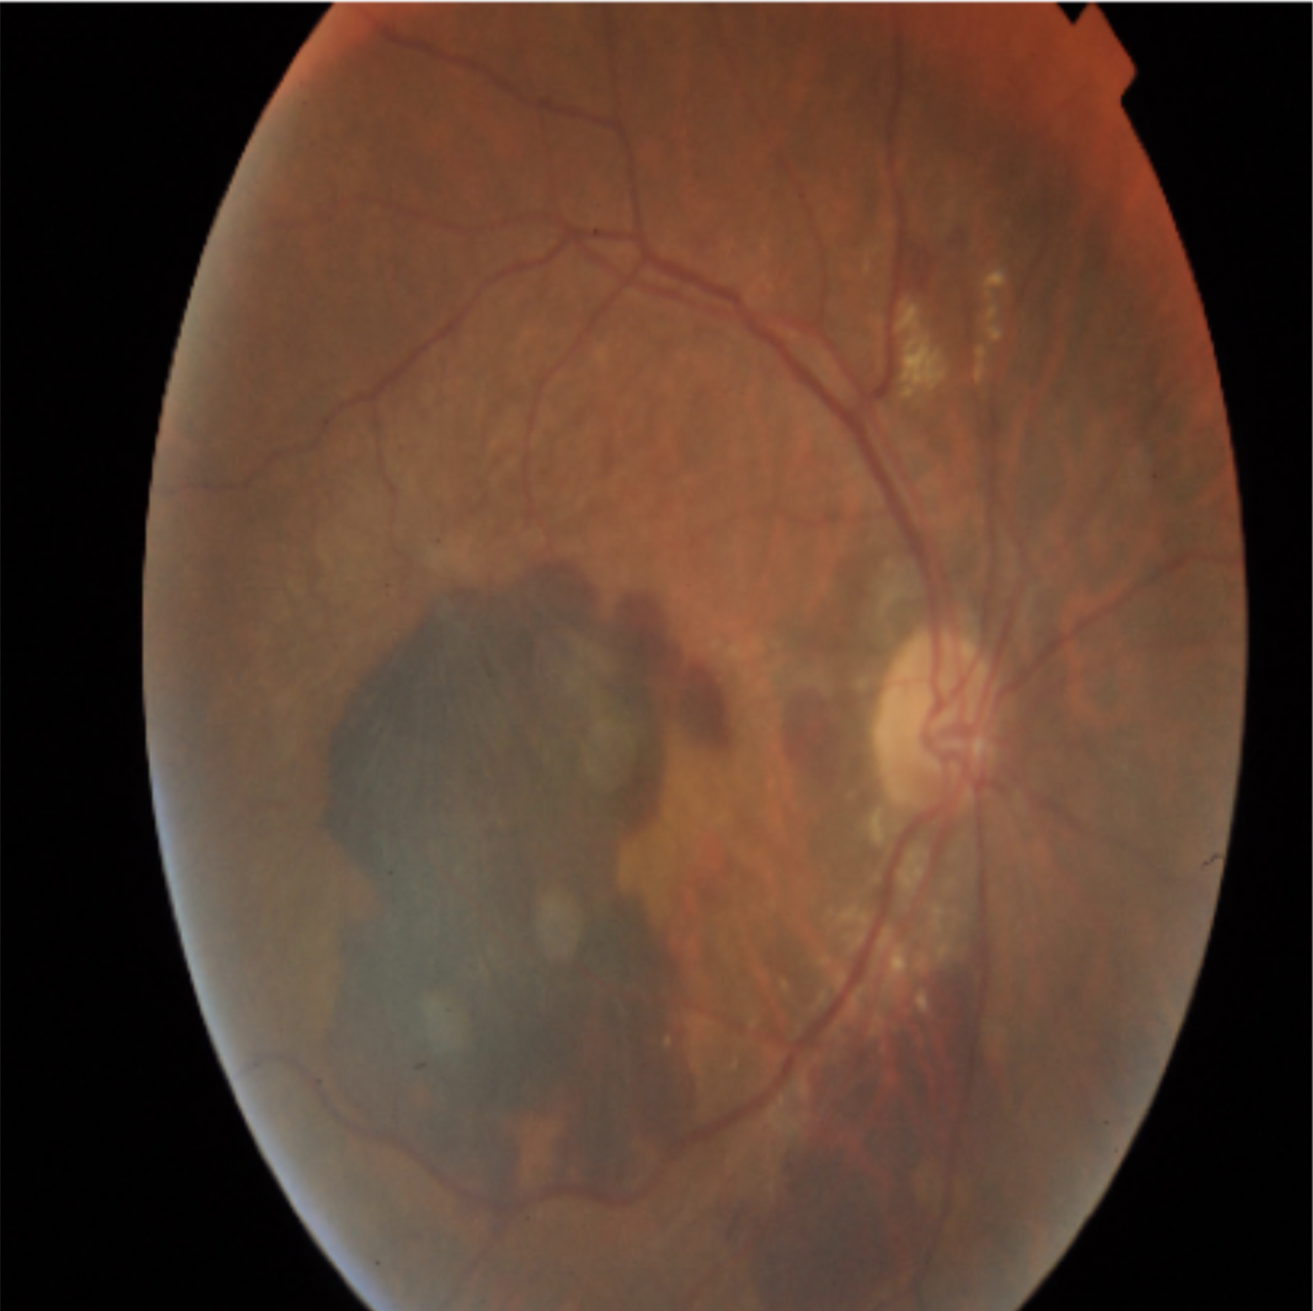
Understand the model: Success
PDR

Slide 28
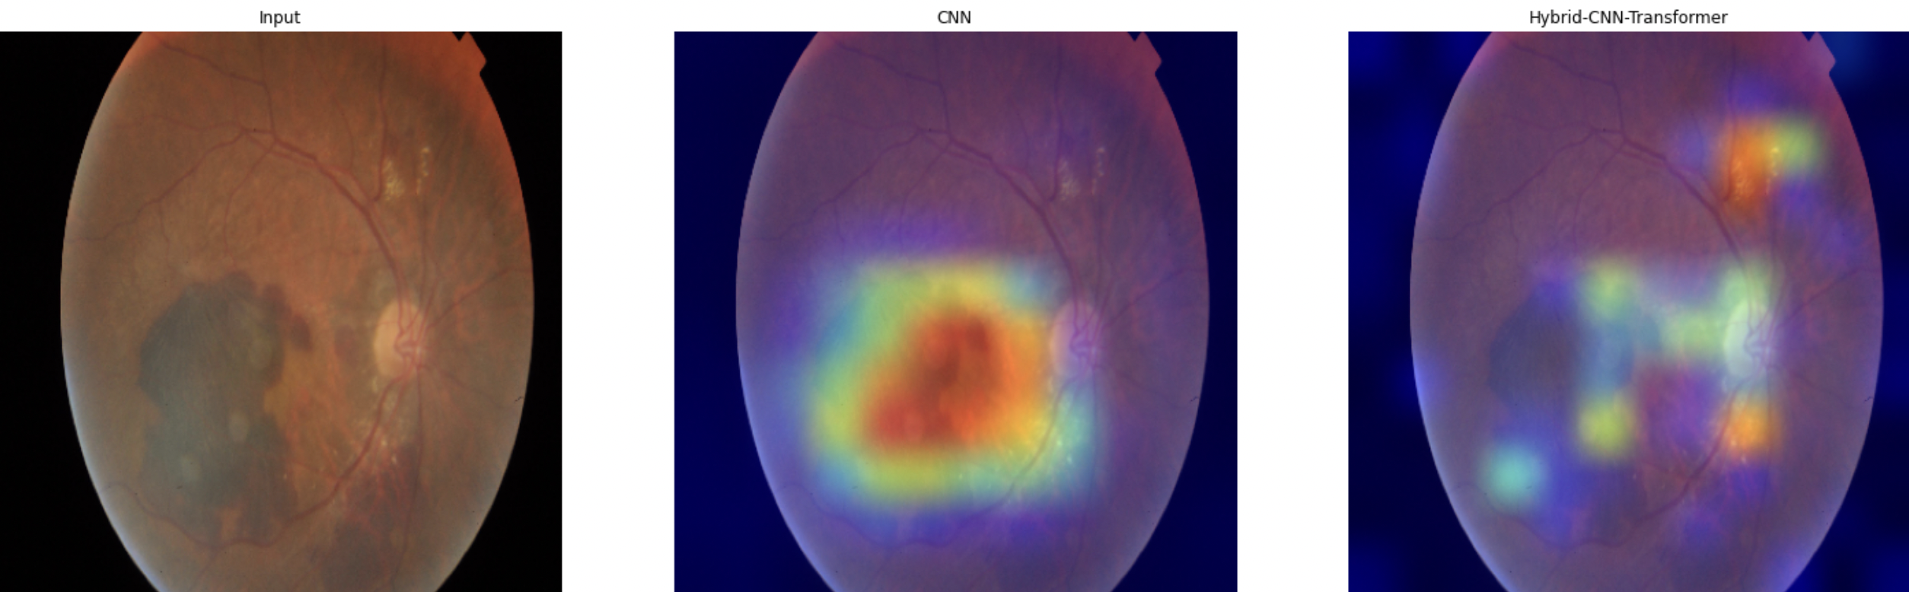
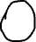
Understand the model: Success
Notes:
Here the model missed the most important part to higlight which is the optic nerve that big circular yellow thing at the extreme right, and highlighted hard exudates and the hemorrage.

Slide 29
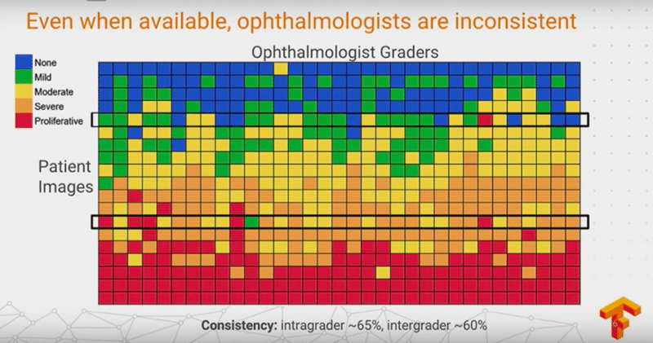
Challenges
Google showed that ophtalmologists' diagnoses differ for same fundus image. Source: (Krause et al., 2017)
Notes:
Here the model missed the most important part to higlight which is the optic nerve that big circular yellow thing at the extreme right, and highlighted hard exudates and the hemorrage.

Slide 30
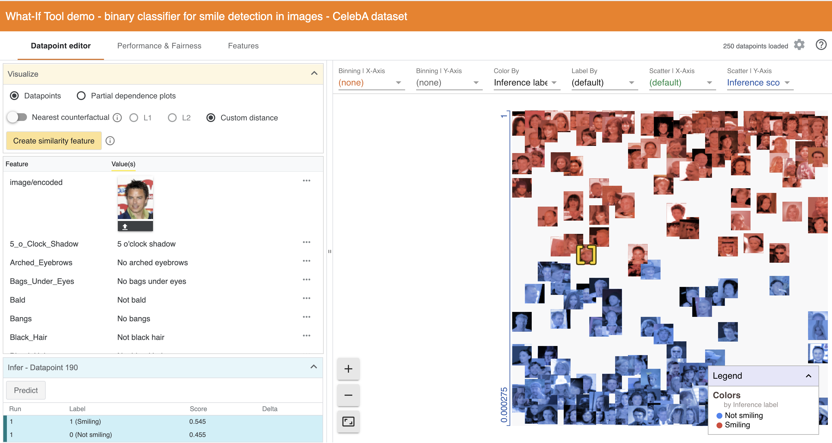
What-If
Source: https://pair-code.github.io/what-if-tool/get-started/
Notes:
Here the model missed the most important part to higlight which is the optic nerve that big circular yellow thing at the extreme right, and highlighted hard exudates and the hemorrage.

Slide 31

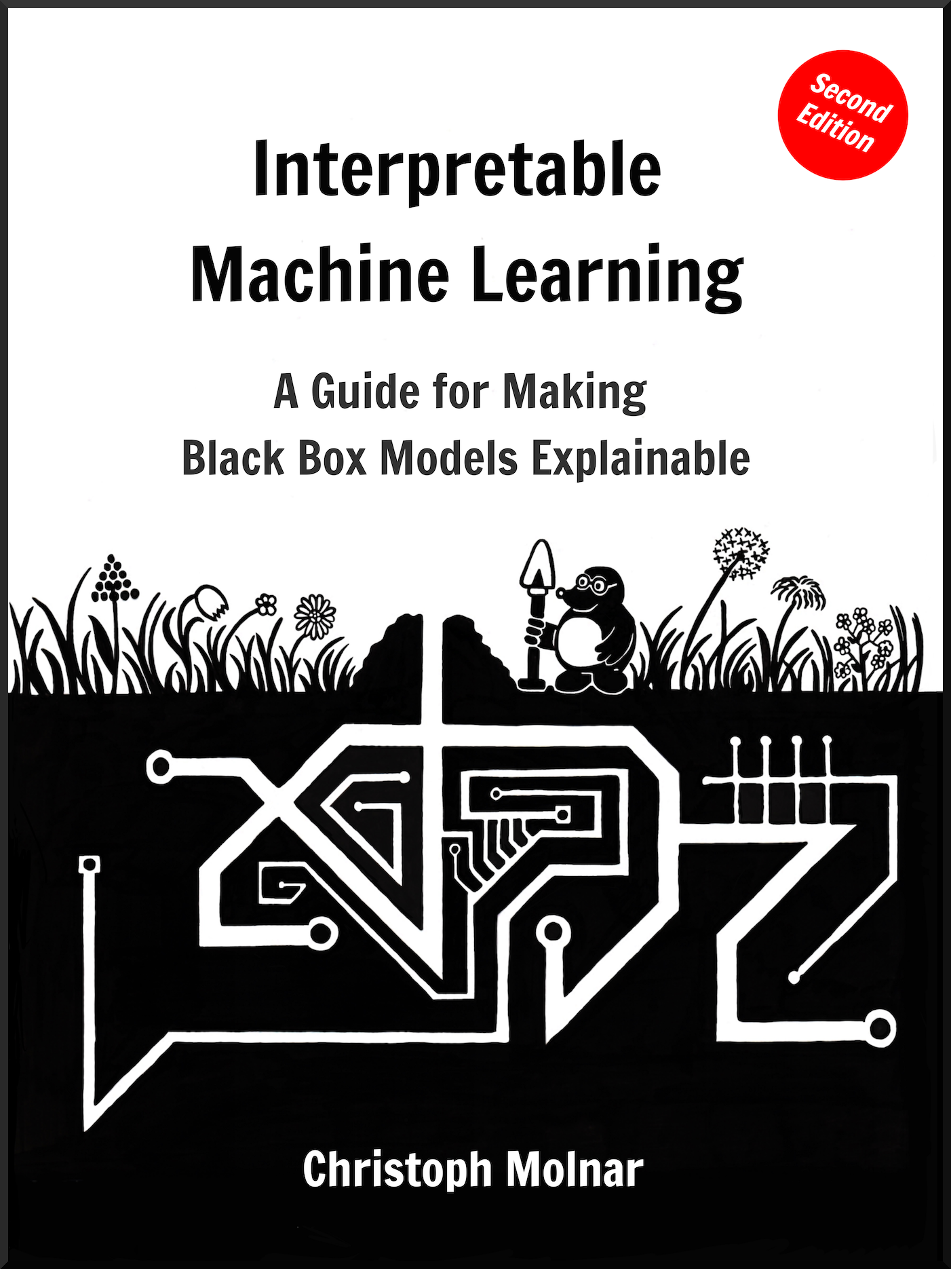
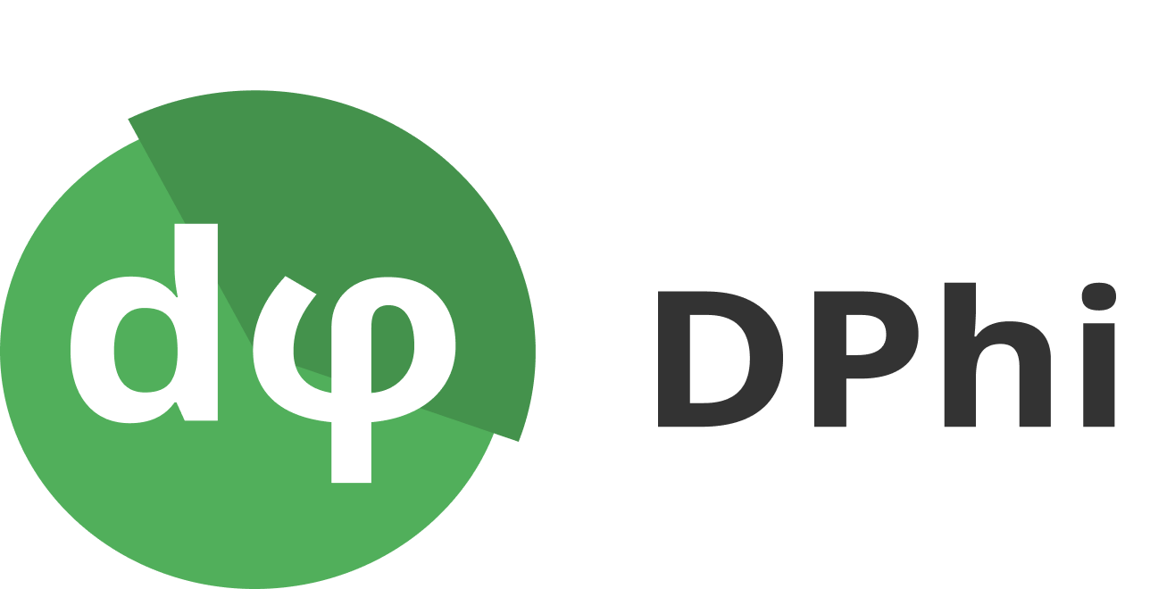
Resources
Notes:
Here the model missed the most important part to higlight which is the optic nerve that big circular yellow thing at the extreme right, and highlighted hard exudates and the hemorrage.

Slide 32
Section title goes here
Thank you! Questions?

